Slide 1
KINETICS OF GROWTH AND DYE REMOVAL BY ISOLATED BACTERIUM - Achromobacter xylosoxidans(DDB-6)
Members
Sandhya M (711520BBT040)
Sukla G (711520BBT047)
Sushmitha P (711520BBT049)
UNDER THE GUIDENESS OF
Dr.Harish B S ,Assistant Professor, Dept of Biotechnology

Slide 2
TABLE OF CONTENT
INTRODUCTION
LITERATURE REVIEW
3. AIM AND OBJECTIVE

Slide 3
INTRODUCTION
Textile industry is one of the greatest generators of liquid effluent pollutants due to the high quantities of water used in the dyeing Processes.
Many dyes,especially alizarin red, Coomassie brilliant blue and cristal violet are released into ecosystems through waste water.
Discharge of these colored effluents into the rivers and lakes reduce dissolved oxygen concentration, thus creating anoxic conditions that are lethal to resident organisms .
Most of the liquid and solid effluents from textile industries are treated by physical and chemical methods such as flocculation, adsorption, filtration and oxidation.

Slide 4
INTRODUCTION
Nevertheless, the use of microorganisms or microbial enzymes or the combination of this offers a better result with economic viability.
The use of microbes does not only ensure a non-toxic process but also have the capability to de colorize very complex synthetic dye.
Many microorganisms belonging to different taxonomic groups of bacteria, fungi, actinomycetes and algae have been reported for their ability to decolorize dyes.
Colored wastewater released from the textile industries can contain between 10 and 200 mg/L of dye and a mixture of other organic and inorganic chemicals and additives .

Slide 5
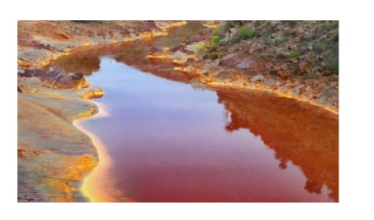
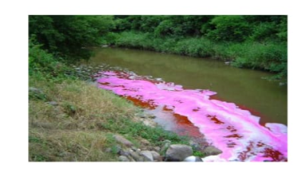
Bio-remediation is a nonhazardous, costefficient, environment-friendly, and often more effective alternative to conventional methods for the treatment of textile waste.

Slide 6
AIM
To isolate dye decolorizing from the bacteria(Achromobacter xylosoxidans) and measure its statistical optimization of media components.

Slide 7
OBJECTIVES
To isolate and grow dye de-colorizing bacteria
To prepare mineral media
To prepare the dye
To study the growth kinetics of the isolated bacterium
To study the statistical optimization of the media components

Slide 8
MATERIALS AND METHODS INSTRUMENTS REQUIRED: Weighing balance, Water bath, Laminar airflow chamber, shaking incubator, Refrigerated Centrifuge, Autoclave, Incubator, Vortex mixer, UV-visible spectrometer. DYES UTILIZED Various dyes which are prominent in the textile industry such as Alizarin Red, Coomassie Brilliant Blue and Crystal Violet.

Slide 9
METHODOLOGY: SAMPLE COLLECTION Effluent water samples collected from a textile factory located in Tiruppur, were used as a source to isolate bacteria with distinct morphological colony characters capable of decolorizing selected industrial dyes. The water samples were collected in airtighT through ordinary filter paper to remove large suspended particles. ISOLATION OF BACTERIA: The samples that were collected by the steps were isolated and stored in the laoboratory.

Slide 10
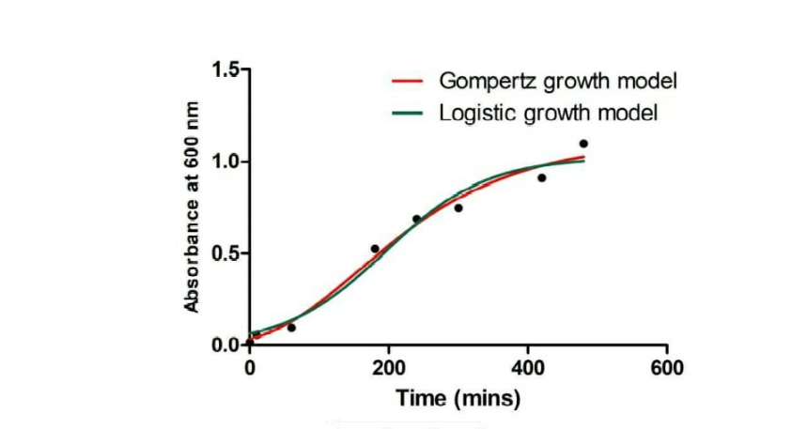
RESULTS ISOLATION OF BACTERIA: The bacterial culture was grown in the agar media with the mixture of crystal violet.Here we use crystal violet as degrading dye.As a result, three colonies of DDB were observed.We isolated the bacteria DDB-6 (Achromobacter xylosoxidans) from the mother culture which is is a Gram-negative, aerobic, oxidase and catalase-positive, motile bacterium with peritrichous flagella, from the genus Achromobacter. It is generally found in wet environments.

Slide 11
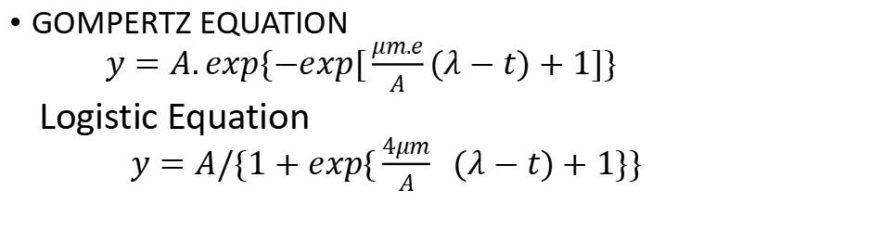
Growth Curve Analysis: Growth curve analysis is a data reduction technique: it is used to summarize longitudinal data into a smooth curve defined by relatively few parameter for descriptive purposes or further inquiry.
GOMPERTZ EQUATION $y=A.exp\{−exp[\frac{μm.e}{A}(λ−t)+1]\}$ Logistic Equation $y=A/\{1+exp\{\frac{4μm}{A}$ ($λ−t)+1\}\}$

Slide 12
REFERENCE
Manikandan, N., S. Surumbar Kuzhali, and R. Kumuthakalavalli. "Biodegradation of textile dye by using achromobacter xylosoxidans GRIRKNM11 isolated from dye polluted site." J. Environ. Anal. Toxicol 2.08 (2012): 8-11.
Sari, Silvia Kurnia, et al. "Comparison of nutrient-rich and limited media in the production of biosurfactant by Achromobacter xylosoxidans BP (1) 5." Malaysian Journal of Microbiology 18.2 (2022): 215-221.

Slide 13
THANK YOU

